Slide 1
A Smart Web App for Attendance Taking
50.012 Project by
Nickson Guay
Arshi Dalvi
Steven Kong
Aishwarya Prabhat

Slide 2
Problem Setting
In SUTD the current method of attendance taking utilizes Learning Catalytics
Students are easily able to transfer the ‘password’ over to their friends
Code is persistent till the end of class
Defeats the purpose of taking attendance at all

Slide 3
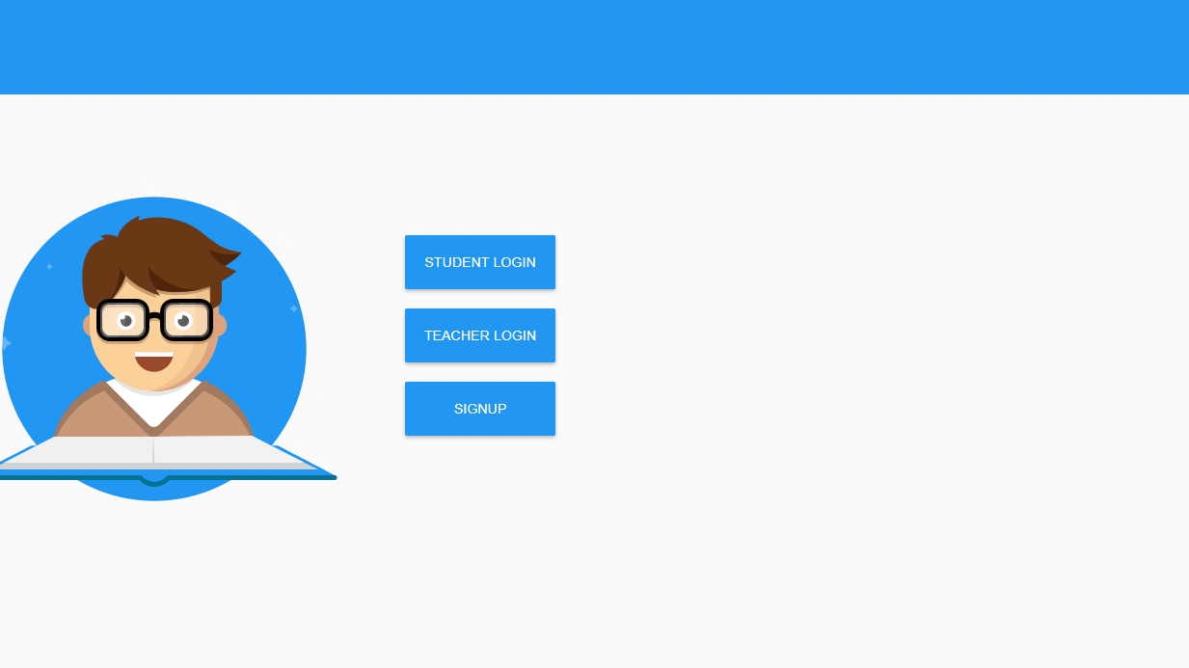
Our Solution
A web-socket communication-based web app for attendance taking
30s timer for passcode expiry
Unique ID login for students and teachers
Quick, simple and user-friendly
A slight bit of ‘fun’

Slide 4
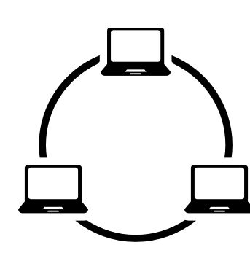
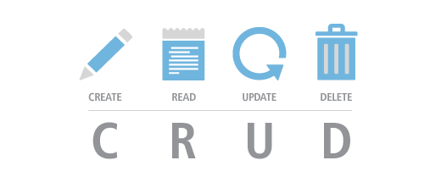
Concepts Applied
Web sockets

Slide 5
Demo
Thank you ☺

